Slide 1



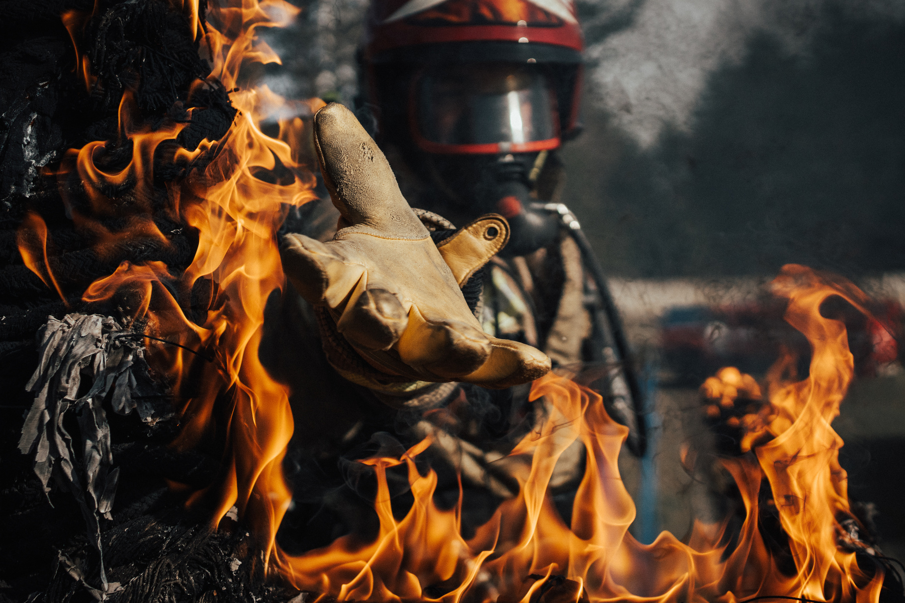

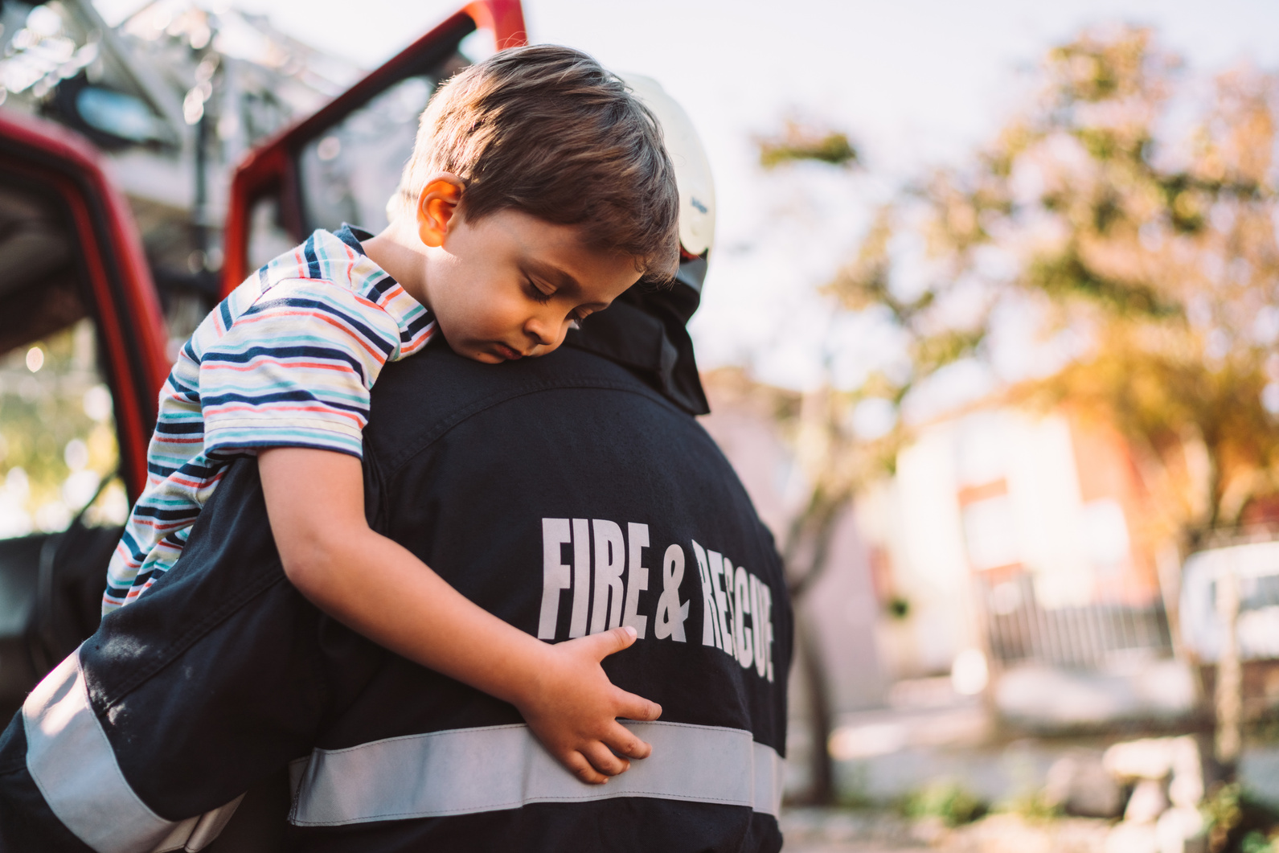


Kiwi Resource Protection Co., Ltd
FOAM TRANSITION
MASTERCLASS
2025
Smart solutions for a sustainable future
Date: 31st July & 1st August 2025

Slide 2

1
WELCOME
Team KIWI would like to welcome all participants to our masterclass on Class B firefighting foams.
While you are with us, your safety and wellbeing
is our highest priority.
Please allow us to begin the masterclass with a safety briefing from the Holiday Inn team.
If you have any concerns, please do not hesitate to intervene or ask one of our team to assist.
YOUR PARTNER IN EMERGENCY MANAGEMENT

Slide 3
2
RECOGNITIONS
I would like to recognize all of you and thankyou for
taking an interest in the future of successful and
sustainable firefighting our industry.
As an industry, and a region, we have some big
challenges ahead of us.
If we can all understand the complexities of selecting and using non-fluorinated foams then we will be able to better manage fires to save lives, assets, and protect our communities.
YOUR PARTNER IN EMERGENCY MANAGEMENT

Slide 4





3
RECOGNITIONS
I would also like to recognize our VIP guests, subject
matter expert speakers and our key business partners for joining and supporting this event.
Please take the time during breaks to visit them and learn how they each contribute to our collective goal.
Smart solutions for a sustainable future
YOUR PARTNER IN EMERGENCY MANAGEMENT

Slide 5
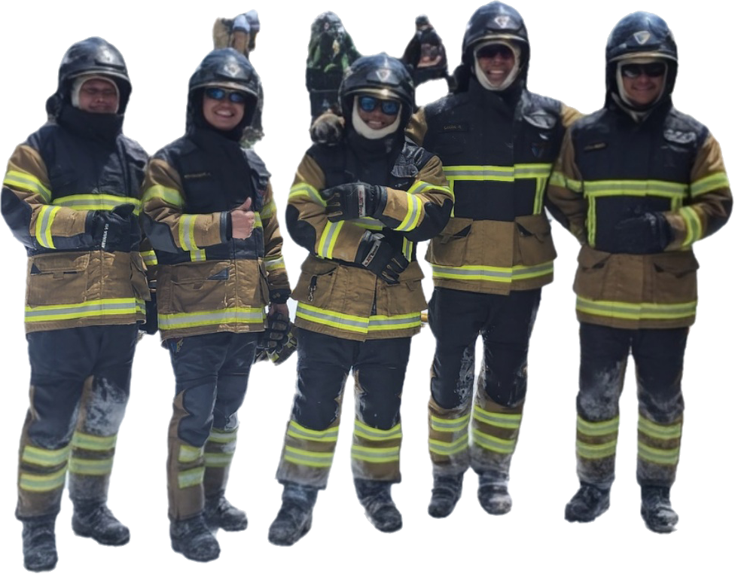
4
RECOGNITIONS
I would like to recognize and say a huge thanks to Team KIWI who have tirelessly worked on planning and organizing this event.
K. Sheri: Accounts and Administration Director
K. Bright: KRP General Manager
K. Neen: Sales and Marketing Manager
K. Akarinth: Project Manager - Foam and retardants
K. Aidan: Service Manager and his team at IRPC
K. Paul, K. Dear & K. Shannay DFS Logistics services
P. Dow: KRP special advisor
N. Gabby: Boss of all
YOUR PARTNER IN EMERGENCY MANAGEMENT

Slide 6
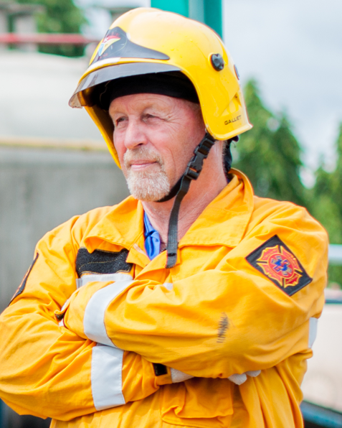
5
SPECIAL RECOGNITION
Finally, I would like to pay special recognition to the
gentleman who started all this more than 35 years
Ago. Mr. Dave Davey.
In the early days of Thailand's oil and gas facility
development, Daves introduction of international
Emergency response tactics helped us to maintain a
safe and reliable industry.
YOUR PARTNER IN EMERGENCY MANAGEMENT

Slide 7
6
EVENT PURPOSE
During my 30+ years as a professional firefighter and
emergency response manager in the oil and gas
industry I have seen many incorrect decisions made
when selecting and using firefighting foams.
I have personally been using fluorine free foams since
2002 in New Zealand.
The next two days is an opportunity for you all to learn
and refresh on the critical aspects of selecting and
using fluorine free foams.
YOUR PARTNER IN EMERGENCY MANAGEMENT

Slide 8
7
THE FUTURE OF ER
Today's world of emergency response is radically different to 15+ years ago.
Improved engineering, safety systems, and reliability our ERT’s have less chance to respond to real incidents.
Therefore, we need to spend more time conducting realistic training to ensure our teams have the right knowledge and skills for successful incident management.
YOUR PARTNER IN EMERGENCY MANAGEMENT

Slide 9
8
THE FUTURE OF ER
It is critical that we all take advise from professionals with proven real time industry experience.
Unfortunately, in today’s world we have too many textbook experts giving incorrect advice, not just here in Southeast Asia but all over the world.
We are seeing many AI generated statements in advisors reports and statements which are technically incorrect.
Trust your proven networks and test their experience and knowledge before making key decisions.
YOUR PARTNER IN EMERGENCY MANAGEMENT

Slide 10
9
ENJOY AND NETWORK
Please enjoy the event, network with everyone and please do not be afraid to ask if you have any questions.
We have over 130 specialists in the room from the oil, gas, chemicals manufacturing sectors, aviation, forestry, mining, and municipal fire and rescue services from the Asia Pacific Region.
YOUR PARTNER IN EMERGENCY MANAGEMENT

Slide 11



10
Kiwi Resource Protection Co., Ltd
OUR VIP GUESTS
AND
SPEAKERS

Slide 12


11
Kiwi Resource Protection Co., Ltd

Slide 13
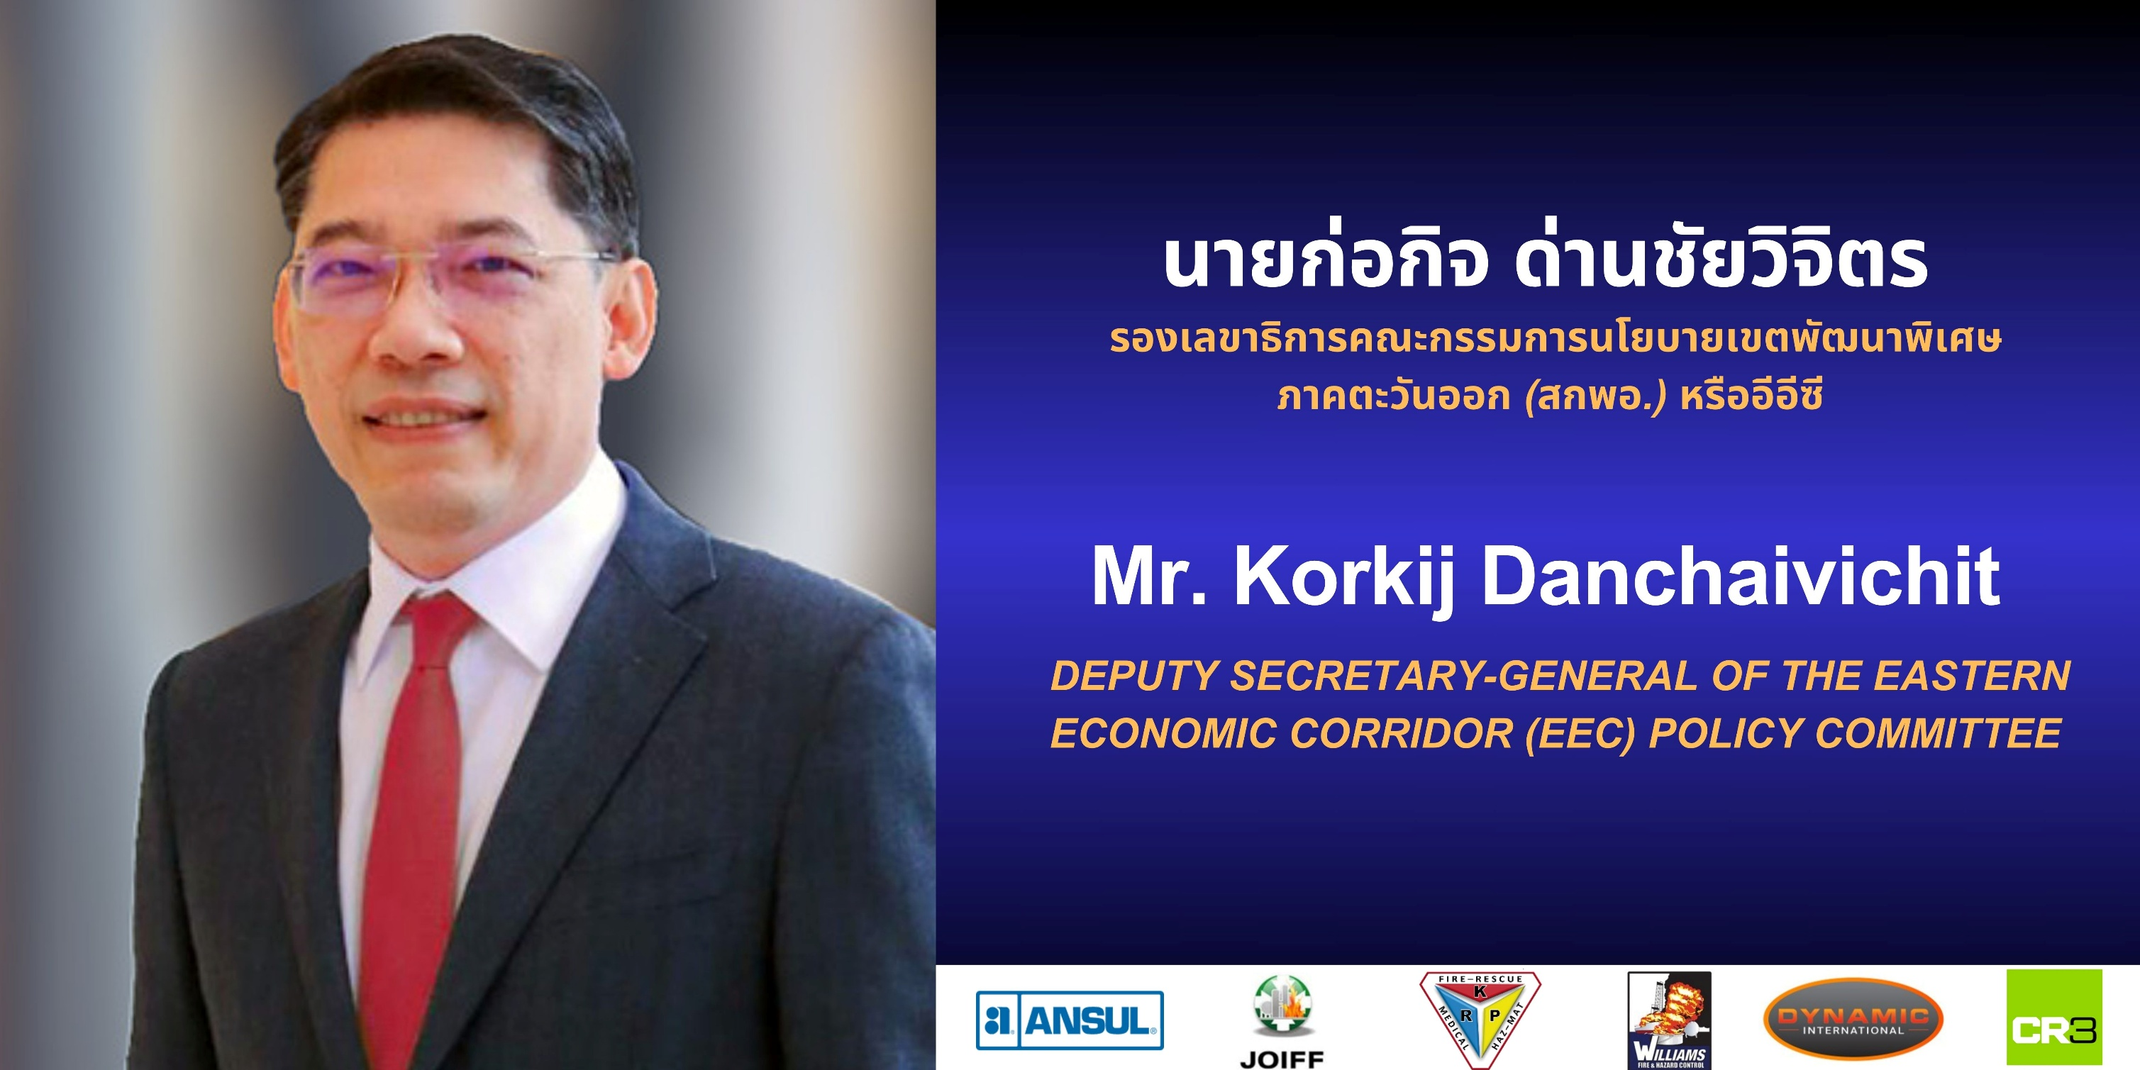
11
Kiwi Resource Protection Co., Ltd

Slide 14



12
Kiwi Resource Protection Co., Ltd
THANKS
Visit our website
24/7 Emergency Hotline
+66 99 003 0873
WWW.KIWIRP.COM

